Slide 1
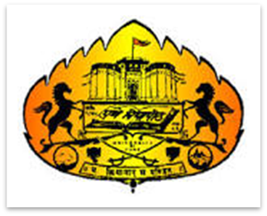
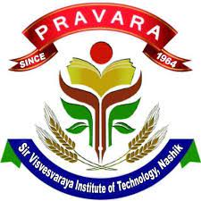
Savitribai Phule Pune University
Affiliated
Pravara Rural Education Society's
Sir Visvesvaraya Institute of Technology, Nashik

Slide 2

Hand Gesture Controller (Virtual Mouse) and Voice Assistant using OpenCV, ML, Python
Sir Visvesvaraya Institute of Technology
Project Presentation on
Project Guide
Dr. Pratibha V. Kashid

Slide 3
Presented by
Sr. No. | Name | Seat No.
1. | Ms. Shipranjali Kiran Gangurde | B190278522
2. | Ms. Snehal Shashikant Sonawane | B190278575
3. | Ms. Pallavi Somnath Avhad | B190278556
4. | Mr. Shubham Shantaram Raut | B190278564
Under the Supervision of
Dr. Pratibha Kashid

Slide 4
Contents
Abstract
Introduction
Aim / Objective
Literature Survey
Problem Statement
Software Requirements
System Architecture
Model Accuracy

Slide 5
Abstract
Mouse is useful in HCI
Wireless mouse is used but it requires dongle to connect
Technologies used : OpenCV, ML, Python
Webcam or built-in camera is used for detection of hand gestures using OpenCV
Algorithm : Media Pipe, a ML framework
Single shot detector model is used
Proposed system will avoid complete interaction with hardwares

Slide 6
Introduction
Hand Gesture Controller (Virtual Mouse) : detects hand tips using OpenCV
Objective : Performing mouse cursor functions using web camera to avoid complete interaction with hardwares
Programming language used : Python and OpenCV (Computer vision library)
Media Pipe is used for tracking hands and hand tips
Pynput, Autopy, PyautoGUI libraries are used for moving around the window screen of the computer to perform all the mouse cursor functions
High accuracy
Does not require GUI

Slide 7
Aim / Objective
To develop the system as an alternative to the regular and traditional mouse system Performing all the mouse cursor functions with having any interaction with the hardware
This can be achieved with the help of web camera that captures all the hand gestures for functions like scroll up, scroll down, left click, right click, drag and drop etc.

Slide 8
Literature Survey
Sr. No. | Year | Proposed Model
1 | 2017 | A novel finger and hand pose estimation technique for real-time hand gesture recognition
2 | 2020 | “Hand Gesture Recognition for Human-Computer Interaction” based on background extraction and contours detection system.
3 | 2021 | “Virtual Mouse Using Hand Gesture” which designed to work with the color detection system, functions works on the number of colors detected

Slide 9
Problem Statement
To track fingertips as a movable object, and to utilize it for mouse functions, the camera should be positioned in a way so that it can see the user’s hands in the right positions. This can be used in space-saving situations, for those patients who don’t have control over their limbs and for other similar cases. It’s a virtual mouse instead of a physical mouse which will work only based on webcam captured frames & tracking colored fingertips.

Slide 10
Software Requirements
Programming Language: Python
Library: OpenCV
Algorithm : Transformational algorithm
Framework: Media Pipe
Libraries : Pynput, AutoPy, PyautoGUI

Slide 11
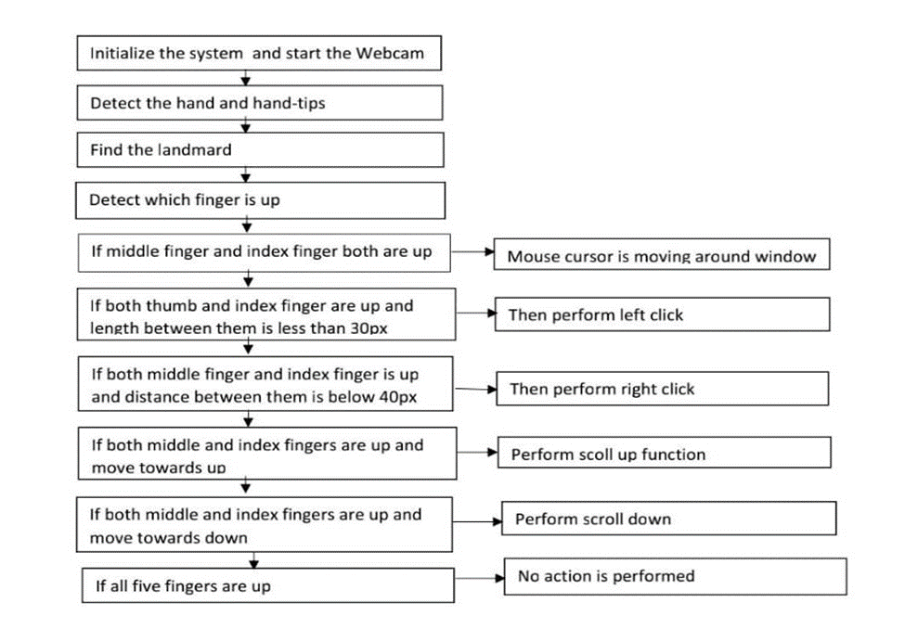
Proposed System Architecture

Slide 12
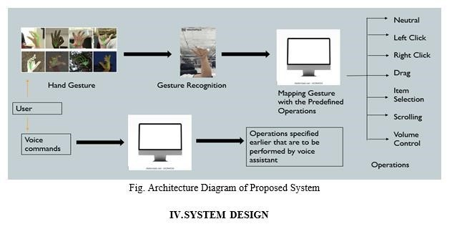
System Design

Slide 13
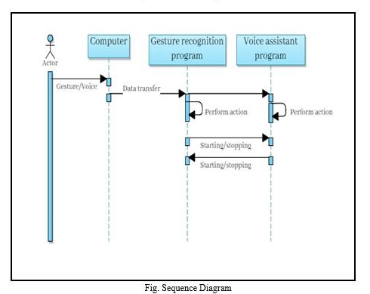
Sequence Diagram

Slide 14
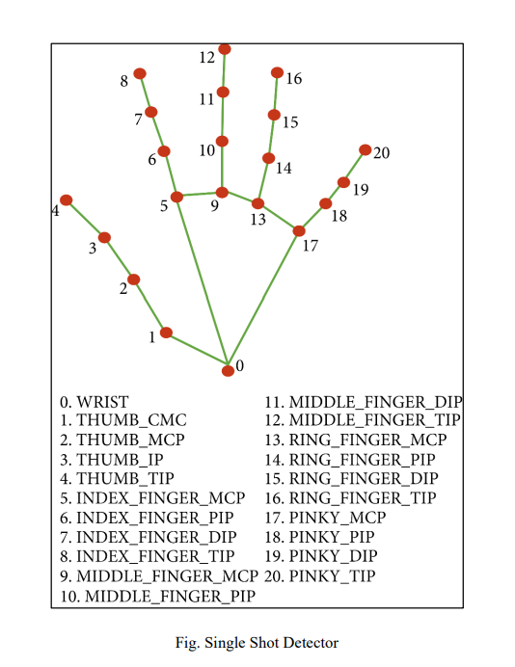
Single Shot Detector Model
Single-shot detector model is used for detecting and recognizing a hand or palm in real time. The single-shot detector model is used by the MediaPipe.

Slide 15
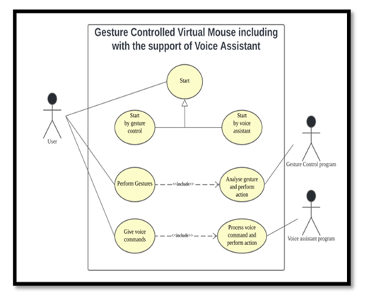
UML Diagram

Slide 16
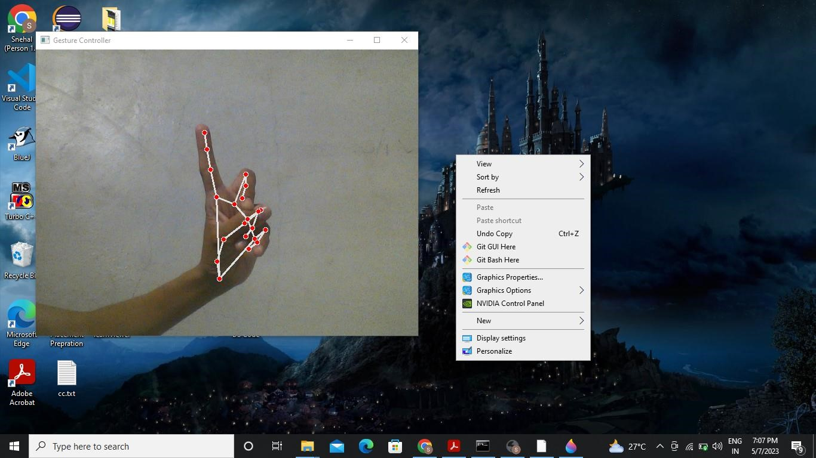
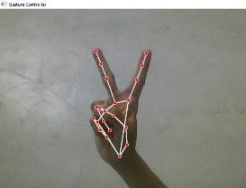
Implementation

Slide 17
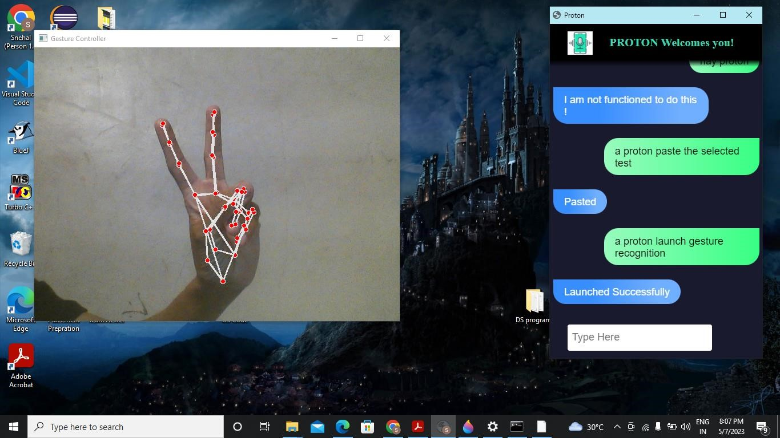
Implementation

Slide 18
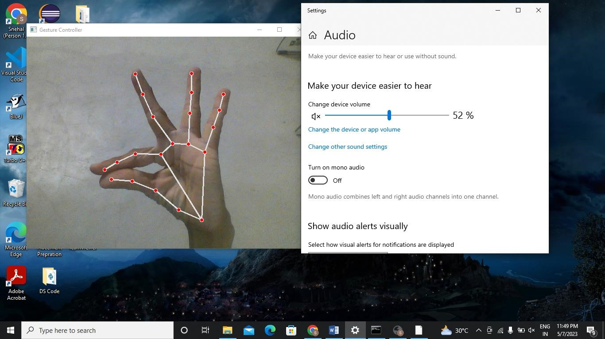
Implementation

Slide 19
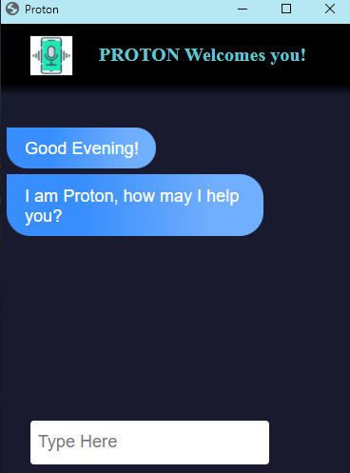
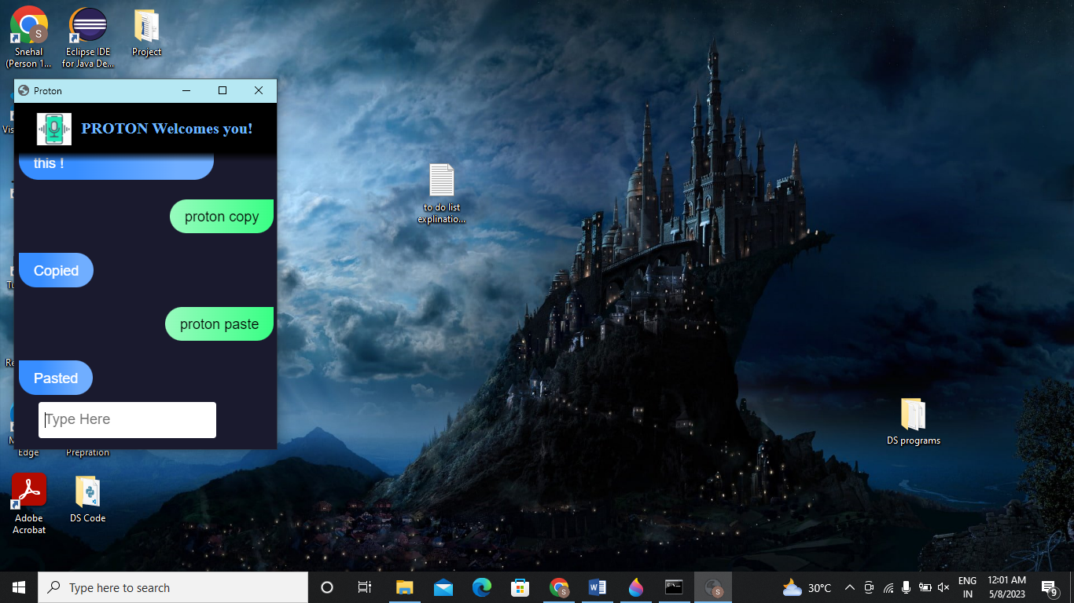
Implementation

Slide 20
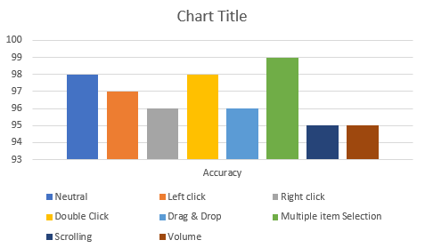
Model Accuracy

Slide 21
Thank You!!!

